Slide 1
Improved AC Coefficients Compression Using Alternate Adaptive Scanning and Multi-Feature Determined Context Arithmetic Coding
Presenter: HSU, HUANG-CHUN

Slide 2
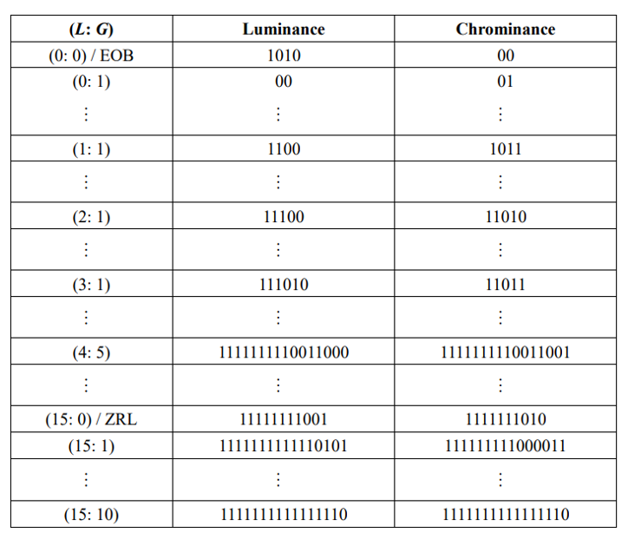

JPEG Coding
Zig-zag scan → Alternative scan
L:G are coded together → Coded separately
Huffman code → CAAC
$$\left[\begin{matrix}33 & −5 & 0 & 0 & −2 & −1 & 0 & 0 \\ −3 & 0 & 0 & −1 & −2 & 0 & 0 & 0 \\ 2 & 0 & 2 & 0 & 0 & 0 & 0 & 0 \\ 0 & 0 & 0 & 0 & 0 & 0 & 0 & 0 \\ 0 & 0 & 0 & 0 & 0 & 0 & 0 & 0 \\ 0 & 0 & 0 & 0 & 0 & 0 & 0 & 0 \\ 0 & 0 & 0 & 0 & 0 & 0 & 0 & 0 \\ 0 & 0 & 0 & 0 & 0 & 0 & 0 & 0\end{matrix}\right]$$
$$−5, −3, 2, 0, 0, 0, 0, 0, 0, 0, 0, 2, −1, −2, −1, −2, 0, …, 0$$
$$\left(0: −5\right), \left(0:−3\right), \left(0:2\right), \left(8: 2\right), \left(0: −1\right), \left(0: −2\right), \left(0: −1\right), \left(0: −2\right), EOB$$
Huffman code for AC coefficients [1]

Slide 3
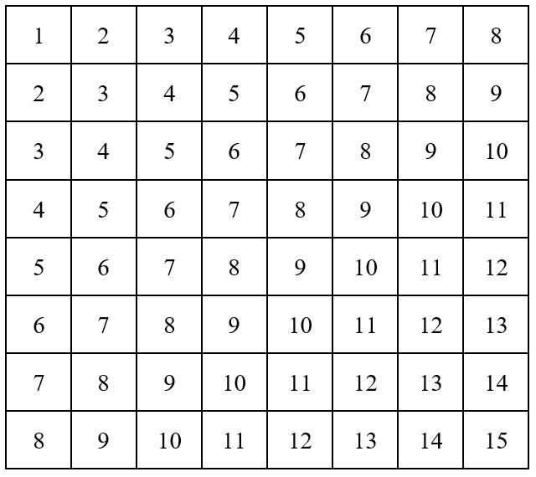
Scanning Order Determination
Zig-zag term should be conserved (ZZ)
but without bias
Probability of zero in neighboring blocks (PZ)
Neighbor is defined as below
Gradient by DC terms (GD)
based on the postulate that DC is encoded prior to AC
ZZ
Neighbor
DC

Slide 4
Scanning Order Determination Cont’d
1
1
1
Some parameters will be set to the power of PZ, GD, PR

Slide 5
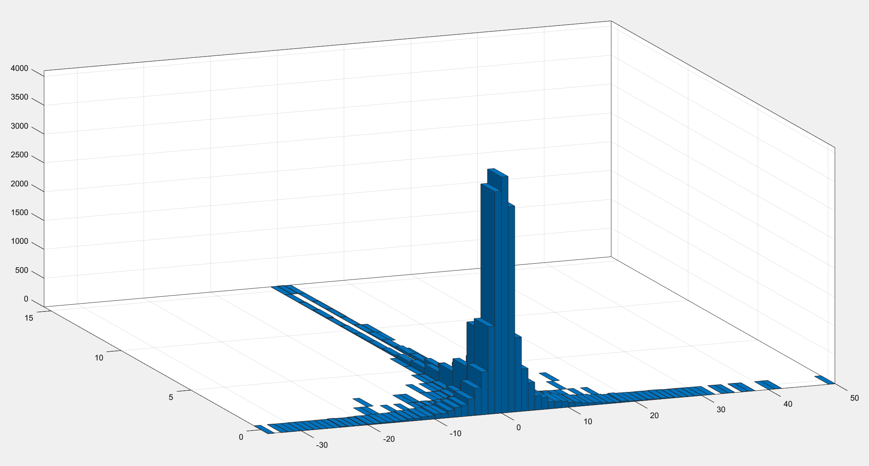
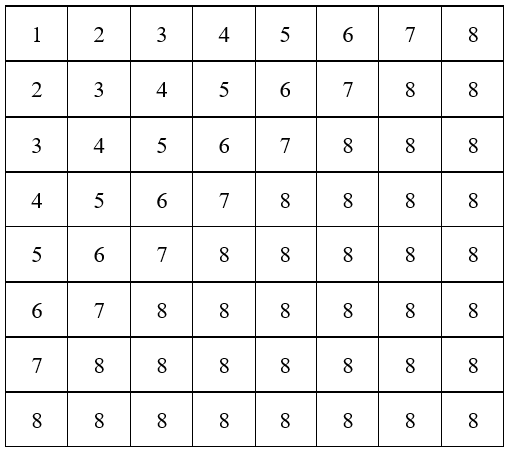
Entropy Coding
Separated Coding
L and G are negatively correlated
3 Contexts are assigned
Therefore L is encoded prior to G
An example of L:G pairs histogram
Context 1 determination

Slide 6
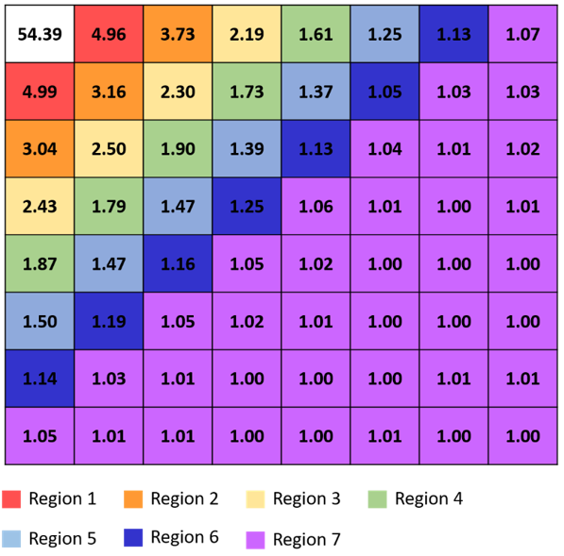
Entropy Coding Cont’d
Context 2’s value is either 1 or 0 if
exceeds the corresponding element o
of threshold vector [5, 3.5, 2.3, 1.8, 1.35, 1.1, 1]
The average absolute values of nonzero coefficients for the quantized 8x8 DCT block [2]

Slide 7
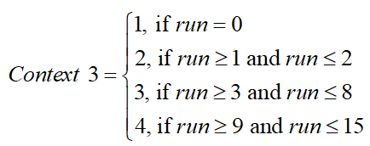
Entropy Coding Cont’d
1
Total number of contexts will be 56

Slide 8
Arithmetic Coding Techniques
Frequency table initialization
Hyper-Laplacian form
Range increment
1
Adaptive bounding
similar to CAVLC
Long-term inputs suppression
1

Slide 9
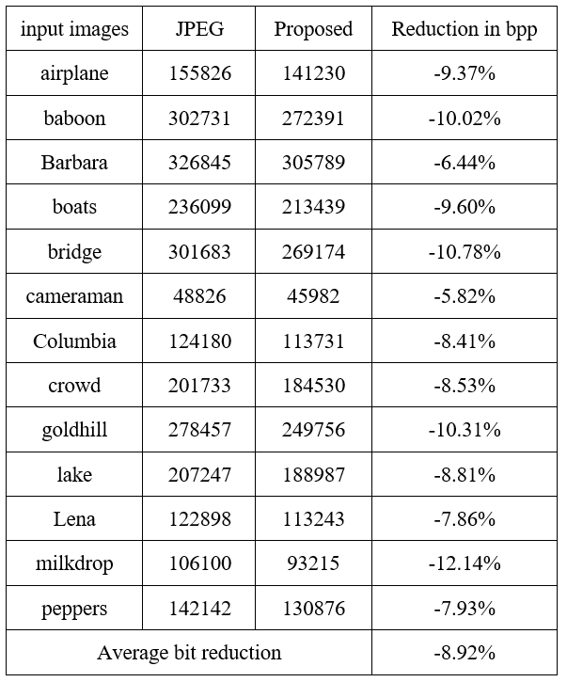
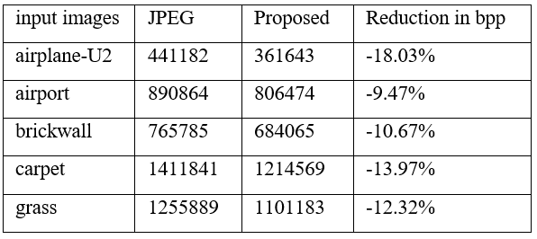
Results
Length of bitstream and the corresponding bpp reduction of AC coefficients
with larger input size (1024*1024)
Length of bitstream and the corresponding bpp reduction of AC coefficients with smaller input size (Mostly 512*512)

Slide 10
Reference
[1] ITU-T T.81 (1992) | ISO/IEC 10918-1:1993, Information technology – Digital compression and coding of continuous-tone still images – Requirements and guidelines.
[2] Y. S. Lu, Context Assignment Algorithms for Image Compression. National Taiwan University, Graduate Institute of Communication Engineering master thesis, Taipei (2021)

